Slide 1
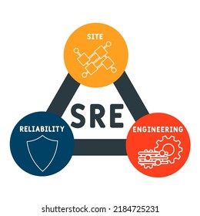
What is SRE ?
Site Reliability Engineer

Slide 2

Difference between SRE and DevOps

Slide 3
DevOps SRE
Philosophy
What need to be done
Business Oriented
Delivering infra for services
CI/CD supporting for business use case
Implementation
How it need to be done
Service Oriented
Reliability for services
Supporting for reliability
Vs

Slide 4
Skills Required for SRE/////////
Programming:
Linux Operating System:
Python, Bash, Go , etc.
Basic DSA + Algorithms
Automation
Basic Linux commands:
cd, ls, mv, grep, etc
Basic Of OS:
Multithreading, Memory Management

Slide 5
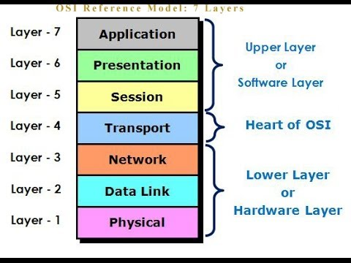
Computer Networking:
TCP / IP protocol
Application layer protocol-HTTP,HTTPS,SSL,SSH,DNS
Transport Layer- port no. , 3 way handshake, TCP vs UDP
Network Layer – IP add, subnet, routing basic
Data Layer – Mac address
Linux networking commands – ping, telnet, traceroute, dig, ifconfig

Slide 6
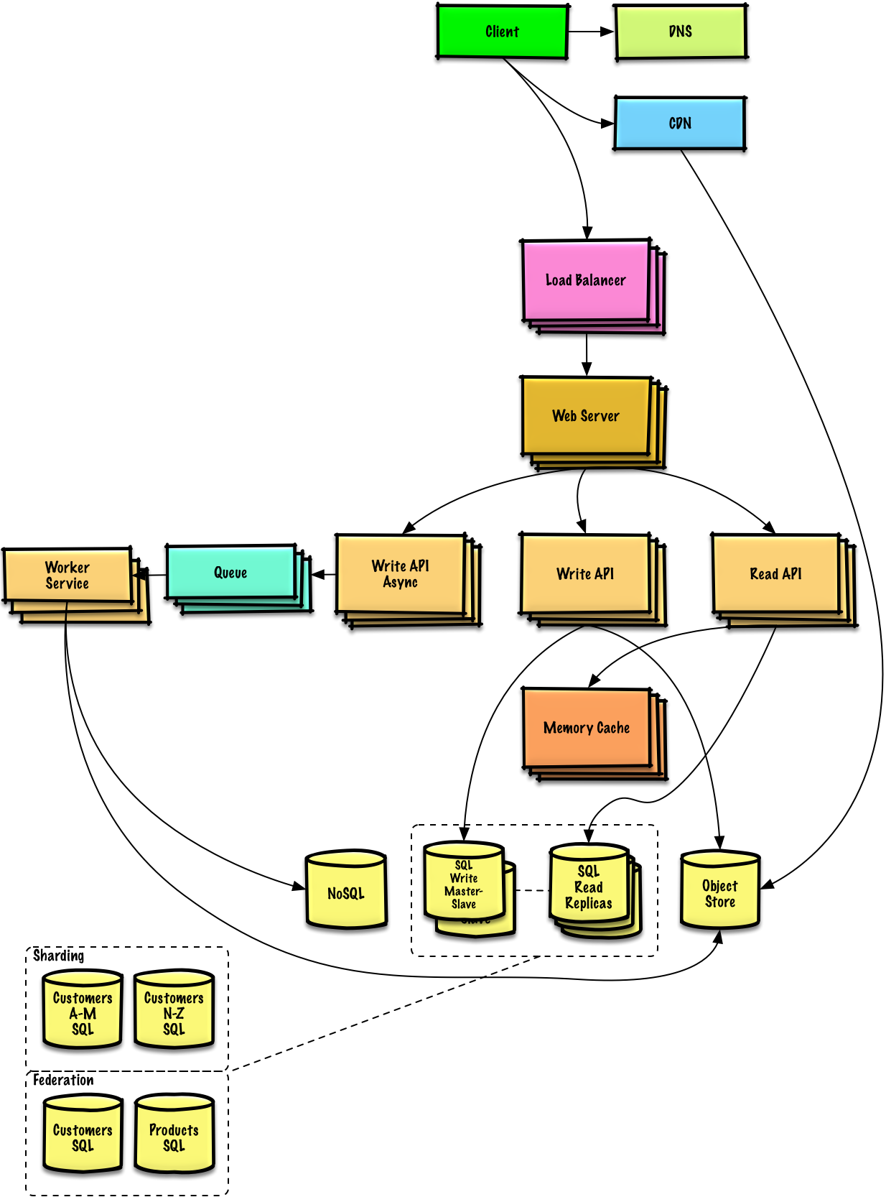
System Design:
Low – High level system design
Load balancer, Web server, DNS, CDN, Caching,
Database, Reverse proxy, CAP theorem
Horizontal vs Vertical Scaling

Slide 7
SRE Responsibilities
Engineering works
Help developer push changes frequently
Monitoring
Efficiency and Performance
Capacity Planning
Changes Management
Emergency Response.

